Slide 1
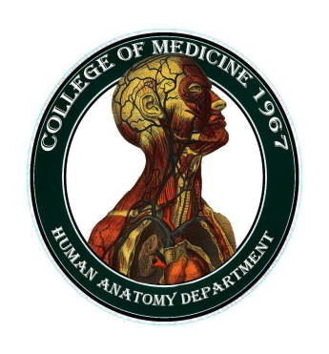
University of Basrah College of Medicine/ Department of Human Anatomy First Class
Medical Biology

Slide 2
Epithelial Tissue
Balqees kadhim

Slide 3
Objectives
What is epithelium
Mean characteristics of epithelium
Function of epithelium

Slide 4
Tissues
Are groups of cells that lie together to accomplish a common function.
During the early developments of embryo, there are three primitive germ layers: ectoderm, mesoderm, and endoderm. From these germ layers the tissues formed and the body is developed

Slide 5
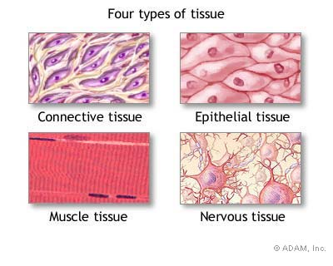
Histology
(groups of cells that are similar in structure and function)
4 Tissue Types

Slide 6
Epithelial tissue
Is one of the four major tissue types in the body
acting as an interface between the body and the rest of the world.
Usually separated from the underlying connective tissue by a thin sheet of basement membrane.

Slide 7
Epithelial tissue
Has a special function–
It must cover all the surfaces of the body

Slide 8
Basal laminae and basement membrane
All epithelium rests on a sheet like extracellular structure called basal lamina that is not visible under the light microscope.
Basal lamina composed of ;
type IV collagen, laminin, entactin and proteoglycan.

Slide 9
The epithelial cells produce the basal lamina .
The term basement membrane usually contains two fused basal laminae or a laminae and reticular
lamina .
The basal lamina forms a sieve like barrier between epithelial and connective tissue.

Slide 10
Functions of the basal lamina
-Structural support
provides strong connection between epithelium and underlying connective tissue.
-Filtering
forms a semi-permeable barrier to regulate the exchange of macromolecules between epithelium and underlying connective tissue

Slide 11
-Angiogenesis
Formation of new blood vessels

Slide 12
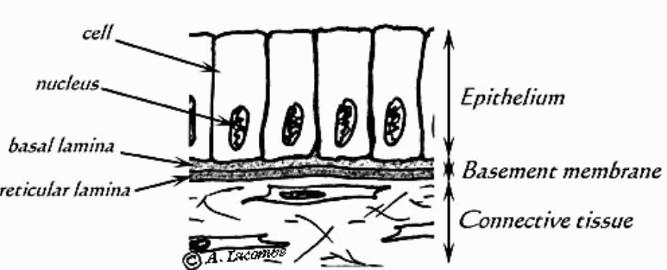
Diagrammatic illustration showing epithelial cells resting on basement membrane.

Slide 13
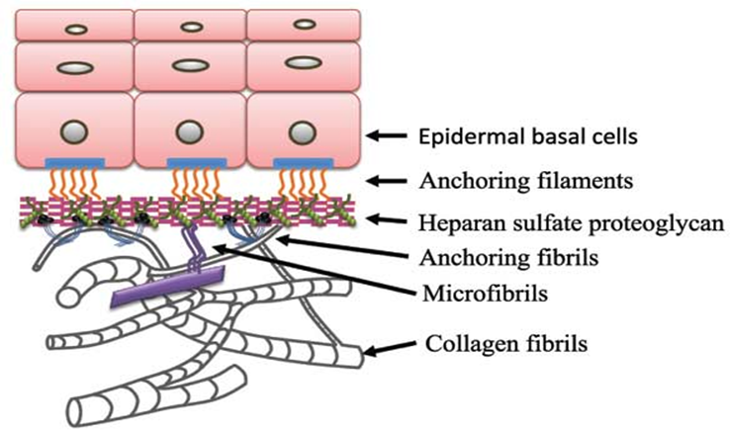

Slide 14
Main Characteristics of Epithelium
-An epithelium is a continuous sheet of connected cells.
-An epithelium contains very little extracellular matrix.
-An epithelium sits on a basal lamina.
-Epithelium does not contain blood vessels
-Derived from all embryonic germ layers.

Slide 15
Function of epithelium
Protection
-Epithelial cells from the skin protect underlying tissue from different conditions
Sensation
Sensory stimuli penetrate specialized epithelial cells.

Slide 16
Secretion
In glands, epithelial tissue is specialized to secrete specific chemical substances.
Absorption
Certain epithelial cells lining the small intestine absorb nutrients from the digestion of food.
Notes:
Cleaning

Slide 17
Excretion
Ex; Kidney and sweat gland
Diffusion
Simple epithelium promotes the diffusion of gases, liquids and nutrients.
Ciliated epithelium assists in removing dust particles and foreign bodies which have entered the air passages.
Cleaning

Slide 18
Reduces Friction
Epithelial cells that line the entire circulatory system reduce friction between the blood and the walls of the blood vessels.

Slide 19
Renewal of cell epithelia
The cells of epithelial tissue are capable of rapid division, which is the process that creates new cells.
The skin, constantly produces new cells to replace the dead cells closest to the skin's outer surface.
Also the cells of tissues lining the digestive tract are undergo continuous division.

Slide 20
Conclusion
Epithelial tissue is that it covers the surfaces of the body, whether external or internal.
It acts as a protective covering or boundary for such surfaces including the outer layer of the skin, as well as the inner surface of "hollow" organs like the stomach, colon, and blood vessels.

Slide 21
Cells are placed very close to each other
Intercellular space is absent or very little and so the intercellular matrix.
All epithelial tissues are supported by connective tissue.

